Slide 1
Puritanism (Age of FAITH)
The 2nd Literary Movement
1500-1700
(approximate dates)

Slide 2
Standards Covered:
ELAALRL1 The student demonstrates comprehension by identifying evidence (i.e., examples of diction, imagery, point of view, figurative language, symbolism, plot events and main ideas) in a variety of texts representative of different genres (i.e., poetry, prose [short story, novel, essay, editorial, biography], and drama) and using this evidence as the basis for interpretation.
ELAALRL3 The student deepens understanding of literary works by relating them to their contemporary context or historical background, as well as to works from other time periods
.

Slide 3
What cultural inferences can we make based on Puritan Art?

Slide 5
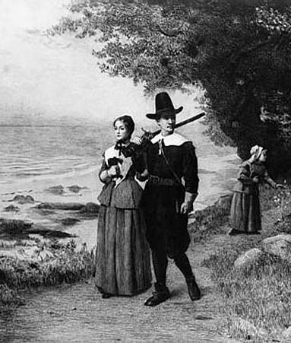

Slide 6
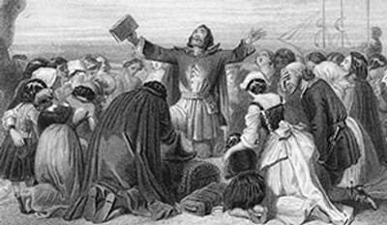

Slide 7
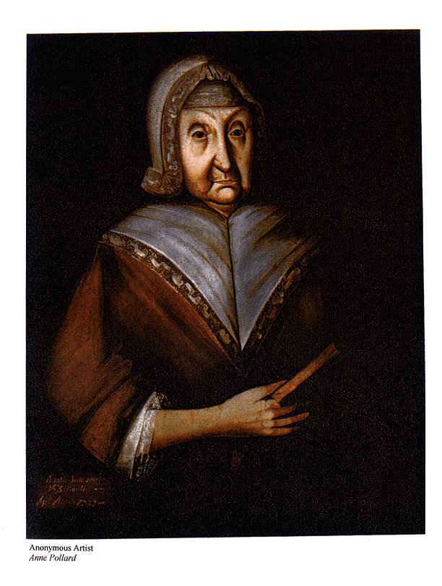

Slide 8
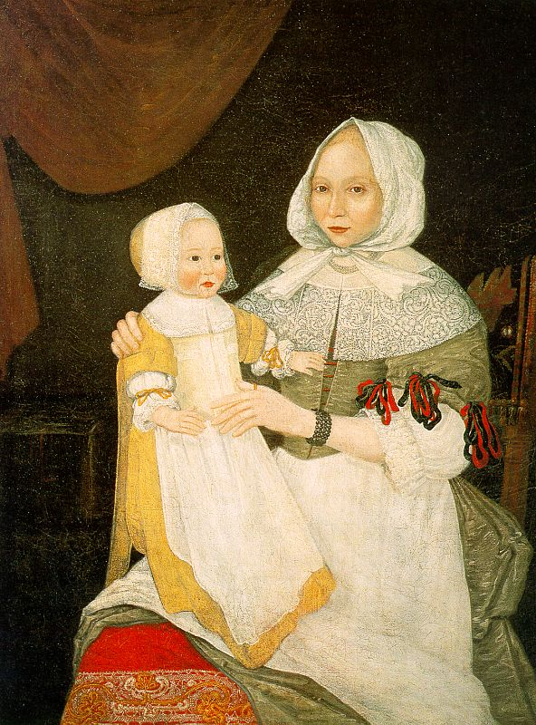

Slide 9
What inferences can we make about Puritan women and wives based on this poem?
Read Ann Bradstreet's poem "To my Dear and Loving Husband "
If ever two were one, then surely we. If ever man were lov'd by wife, then thee. If ever wife was happy in a man, Compare with me, ye women, if you can. I prize thy love more than whole Mines of gold Or all the riches that the East doth hold. My love is such that Rivers cannot quench, Nor ought but love from thee give recompetence. Thy love is such I can no way repay. The heavens reward thee manifold, I pray. Then while we live, in love let's so persever That when we live no more, we may live ever.

Slide 10
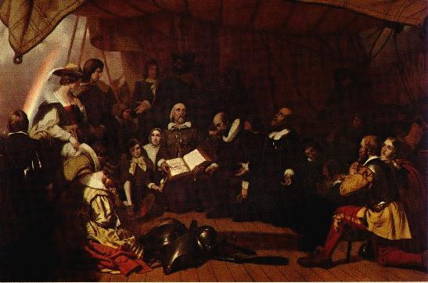
Who were these Puritans?
Puritan is a broad
term referring to a
number of Protestant
groups who sought
to “purify” the Church
of England which
had been closely
connected to
its government.

Slide 11
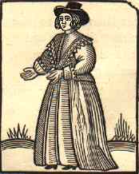
Who were these Puritans?
Puritans wished to
return to a simpler
form of worship and
church organization
described in the New
Testament.

Slide 12
Who were the Puritans Cont…
They wanted to reform their national church by eliminating every shred of Catholic influence
Their attempt to “purify” the Church of England and their own lives was based on the teachings of John Calvin
Left for the new world in 1620 to escape religious persecution and established the Massachusetts Bay Colony.

Slide 13
Puritan Culture

Slide 14
Quote of the week from Puritansermons.com:
"Sin in a wicked man is like poison in a serpent; it is in its natural place."

Slide 15
Cotton Mather (1663-1728)
Promoted inoculation against a small pox epidemic in 1721
Many refused to get inoculated because they believed they were interfering with God’s plan for them and possibly cheating death
When many who had been inoculated died anyway, it became a non-issue for most
Notes:
Recommends inoculation during the small pox epidemic of 1721.

Slide 16
John Winthrop

Slide 17
-from a sermon preached on the way to the New World, spring 1630, by John Winthrop
“For we must consider that we shall be as a city upon a hill, the eyes of all people are upon us. So that if we shall deal falsely with our God in this work we have undertaken, and so cause Him to withdraw His present help from us, we shall be made a story and a by-word through the world: we shall open the mouths of enemies to speak evil of the ways of God and all professors for God’s sake; we shall shame the faces of many of God’s worthy servants, and cause their prayers to be turned into curses upon us, till we be consumed out of the good land whither we are going.”
Notes:
Imagine that you are setting sail to a new land with a group of people. You set out with the hopes of beginning a new way of life, but now you have been on the sea for over a month and your crew has encountered numerous disasters along the way. People are tired, scared, and doubtful. What would your words of inspiration be?

Slide 18
A Puritan primer first published in 1672
Described as leading its “readers through a gallery of death-bed scenes”

Slide 19
A 1661 catechism

Slide 20
Commemorative Death Rings

Slide 23
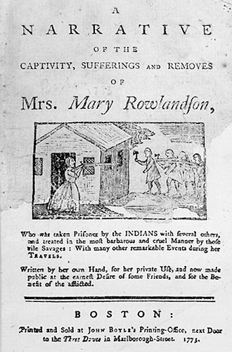
Leading Puritan Writers
Mary Rowlandson
A Narrative of the
Captivity

Slide 24
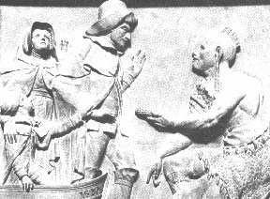
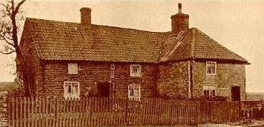
Leading Puritan Writers
William Bradford
Of Plymouth
Plantation

Slide 25
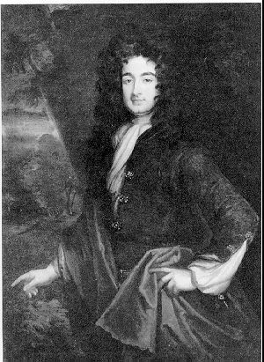
Leading Puritan Writers
William Byrd –
The History of the
Dividing Line

Slide 26
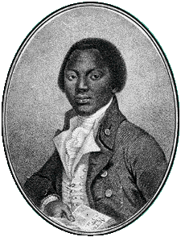
Leading Puritan Writers
Olaudah Equiano –
The Interesting
Narrative of the
Life of Olaudah
Equiano

Slide 27
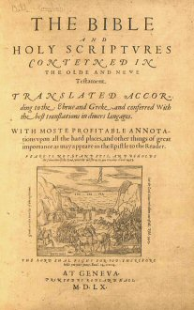
Characteristics of Puritan Writing
The Bible provided a model for Puritan writing – each individual life was a journey to salvation.
They saw a direct connection between Biblical events (allusions) and their own lives.

Slide 28
Puritan Literature
Dominated by religion: theological studies, hymns, histories, biographies, autobiographies
Purpose was to provide spiritual insight and instruction
Regarded fiction and drama as sinful
Used poetry as a vehicle of spiritual enlightenment
Believed in a plain style of writing that had a clear message
Heavy hitters: Anne Bradstreet, Edward Taylor, Increase Mather, Cotton Mather
Cotton Mather
Anne Bradstreet

Slide 29
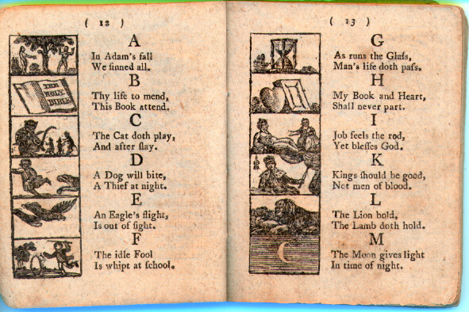
Puritan Writings-A Means to Provide Spiritual Enlightenment, Instruction and Self-Examination
Plain style
Theological studies, hymnals, histories, biographies, autobiographies
They recorded forms of revelation. The Puritans believed that God revealed His purpose to humanity in three principal ways: through the Bible, through the natural world, and through Divine Providence, or God’s direct intervention in human affairs.

Slide 30
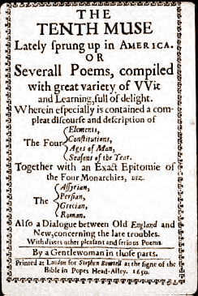
Puritan Plain Style
Reflected style of their lives – spare, simple, straightforward
Characterized by short words, direct statements, and references to ordinary, everyday objects
Only expressed useful or religious ideas
Did not appeal to senses or emotions

Slide 31
Puritan Beliefs
Total depravity: “In Adam’s fall we sinned all” Humankind is totally sinful through the fall of Adam and Eve and damned for eternity.
Predestination: You are “elect” (saved) or “unregenerate” (damned). Salvation belongs to the “elect”, or God’s chosen. No good works will help you become saved.
Limited atonement: Christ died only for the “elect”.
Grace: You could feel God’s grace in an intense emotional fashion. After receiving grace, you were “reborn” have thenceforth full power to do the will of God and the ability to live uprightly to the end.

Slide 32
Puritan Beliefs Cont.
The Puritan community was a theocracy, a government which blends church and state. The church’s officials were the government’s officials. Thus, church and state were not separate.
City upon a Hill Theory: That the new MA Colony would be a place of complete reform (utopia) where God would be found in scripture and a strong work ethic.
Education: A strong belief in education was established in order to read the Word of God. The first public school was founded in 1635 and Harvard College became an icon for educating ministers
.

Slide 33
What do we know about the Salem Witchcraft Trials?

Slide 34
How it started . . .
Betty Parris became strangely ill. She dashed about, dove under furniture, contorted in pain, and complained of fever. The cause of her symptoms may have been some combination of stress, asthma, guilt, boredom, child abuse, epilepsy, and delusional psychosis.
Talk of witchcraft increased when other playmates of Betty, including eleven-year-old Ann Putnam, seventeen-year-old Mercy Lewis, and Mary Walcott, began to exhibit similar unusual behavior.
A doctor called to examine the girls, suggested that the girls' problems might have a supernatural origin. The widespread belief that witches targeted children made the doctor's diagnosis seem increasingly likely. -Douglas Linder

Slide 35
Causes of Witchcraft Hysteria in Salem
11. Strong belief that Satan is acting in the world. ---------"The invisible world": disease, natural catastrophes, and bad fortune
2. A belief that Satan actively recruits witches and wizards ---------Prior witchcraft cases
3. A belief that a person afflicted by witchcraft exhibits certain symptoms.
4. A time of troubles, making it seem likely that Satan was active. ---------Congregational strife in Salem Village ---------Frontier wars with Indians
5. Stimulation of imaginations by Tituba (slave).
6. Teenage boredom.
7. Confessing "witches" adding credibility to earlier charges.
8. Old feuds (disputes within congregation, property disputes) between the accusers and the accused spurring charges of witchcraft.

Slide 36
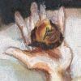
Witch Cake
Tituba, a slave from Barbados, makes a witch cake, drawing suspicion on herself.
A witch cake is composed of rye meal mixed with urine from the afflicted children. It is then fed to a dog. The person is considered bewitched if the dog displays similar symptoms as the afflicted.

Slide 37
Spectral Evidence
“The girls contorted into grotesque poses, fell down into frozen postures, and complained of biting and pinching sensations. In a village where everyone believed that the devil was real, close at hand, and acted in the real world, the suspected affliction of the girls became an obsession.” Douglas Linder

Slide 38
The Trials
By the end of 1692, over 200 people were jailed and standing accused of witchcraft.

Slide 39
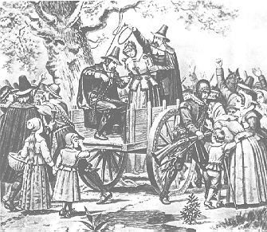
Hysteria Strikes
Nineteen men and women were hanged, all having been convicted of witchcraft
Another man of over eighty years was pressed to death under heavy stones for refusing to submit to a trial on witchcraft charges
Many languished in jail for months without trials
At least four died in prison

Slide 40
Why the Hysteria Ended
1. Doubts grow when respected citizens are convicted and executed. -------Rebecca Nurse (jury first acquits, then told to reconsider) -------George Burroughs (recites Lord's Prayer perfectly at hanging) 2. Accusations of witchcraft include the powerful and well-connected. -------Wife of Governor Phips (and others) 3. The educated elite of Boston pressure Gov. Phips to exclude spectral evidence. -------Increase Mather points out the Devil could take the shape of an innocent person: "It were better that 10 suspected witches should escape than one innocent person should be condemned." 4. Gov. Phips bars spectral evidence and disbands the Court

Slide 41
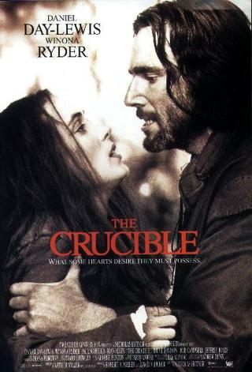
The Crucible by Arthur Miller

Slide 42
Setting
We begin with a play, set in colonial America.
Arthur Miller’s drama The Crucible has its feet in two eras of time, Puritanical New England Salem Witch Trials of 1692 and Cold War Washington of the 1950’s. Miller presents America’s deepest past in order to make a modern point. He saw that, as the saying goes, “Those who do not learn from history are doomed to repeat it.”

Slide 43
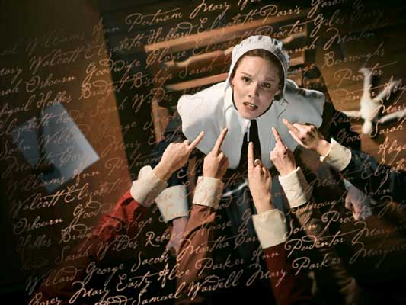
How the play begins . . .
Group of girls caught dancing in woods with Tituba
Among the group is the Daughter of Rev. Parris and the daughter of Thomas and Anne Putnam
Girls feign sickness and possession
Both families demand that the possessors be found and punished

Slide 44
Works Cited
Famous American Trials. Salem Witchcraft Trials 1692 http://www.law.umkc.edu/faculty/projects/
ftrials/salem/SALEM.HTM

