Slide 1
Georgia Milestones End of Course (EOC)
Information for Students

Slide 2
Test Schedule & Plan
A copy of the schedule can be found at www.hoochtestinglocker.weebly.com

Slide 3
Cell Phones & Irregularities
Students are not permitted to use, or bring into the testing environment, any electronic device that could allow them to access, retain, or transmit information (e.g., cell phone, smartphone, PDA, electronic recording device, camera, playback device, SMART WATCHES.
Devices are not allowed in the testing environment and possession or improper use of such devices during testing may result in disciplinary action in accordance with the system's student code of conduct and/or test invalidation.

Slide 4
Governor’s Office of Student Achievement Change Analysis
Formerly called Erasure Analysis
Includes online testing as well as paper/pencil
Analysis of erasures and analysis of online changes

Slide 5
Administration Protocols
Have students turn on their devices
Students without a device may sign out one of the extras that will be in testing locations
Check to see that students have at least 80% power and the DRC icon on their home screen

Slide 6
Test Design Change
Beginning in Spring 2017, students will take the 5 question section of the ELA test that contains the extended writing prompt on day 1 of testing.
Question 59 – Constructed response (only a couple of paragraphs)
Question 60 – Extended response (longer written essay)
Science will have constructed response items this year

Slide 7
Content Area/Course | Test Section(s) | Minimum Time Per Section(s) | Maximum Time Per Section(s)
English Language Arts, Reading and Evidence-Based Writing | 1 | 70 | 90
English Language Arts | 2 and 3 | 60 | 75
Mathematics | 1 and 2 | 60 | 85
Science | 1 and 2 | 45 | 70
Social Studies | 1 and 2 | 45 | 70
Test Design
Note: These maximum time limits do not apply to those students who have the accommodation of extended time.
Examiners may NOT stop testing before the minimum time allowed per section unless all students have already submitted their completed section without prompting from the teacher.

Slide 8
Test Design
Operational test items in ELA and mathematics
Field test items in science and social studies
Evidence-Based Selected-Response (EBSR) Items for English Language Arts – a two-part multiple-choice item that requires students to complete both parts
First part answers inferential or key concept question related to text. Includes one correct response
Second part is evidence from the text used to support the inference or idea. May include one or more correct response(s)
Two-point score value with opportunity for partial credit. Part One and Two must be correct to receive 2-Points. One-Point if only Part One is correct.

Slide 9
Online Tools All Students
TOOL | ICON | CONTENT AREA
Periodic Table |  | EOG and EOC Science
Reference/Formula Sheet |  | EOG and EOC Math, EOC Science
Highlighter |  | ALL
Sticky Note |  | ALL
Flag |  | ALL
Line Guide |  | ALL
Online Calculator |  | Grades 6–8 and EOC Mathematics; EOC Science; EOC Economics
Graphing Tool |  | EOC Mathematics only
Cross-off Tool |  | ALL

Slide 10
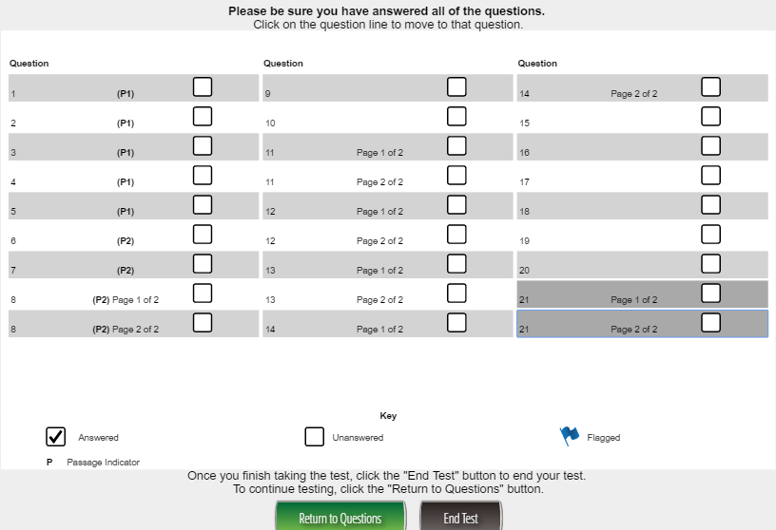
To Correctly Close Out a Section Submit button sets the section to complete

Slide 11
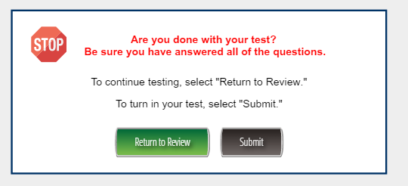
To Correctly Close Out a Section Submit button sets the section to complete

Slide 12
Student Login
The most common login issue is a result of students logging into the WRONG Test Sign In. Remember….”bottom blue gets you through”!

Slide 13
Considerations For Online Testing
Consider the impact on the school network made by things like Youtube, iTunes, Safari Montage, and other streaming Internet services during online testing
We will be asking teachers not testing to schedule instruction in advance to avoid using streaming media during testing sessions
Turn off personal wireless devices during testing. Many of these devices are connected to our Wi-Fi and need to be turned off to reduce the burden on the wireless network
School district owned wireless devices not being used for testing should be limited in use and turned off if possible

Slide 14
Test Practice for Online Administrations
There are three different ways for students to practice for online administrations
We are using the Practice Test with Response Transmission for the System Technology Check
Online Practice
Secure Practice Test
Generic test tickets found in pdf format in General Information of eDIRECT
Test taken through INSIGHT platform
Available year-round
****Practice Test with Response Transmission
Students scheduled and tests printed through Test Administration of eDIRECT
Test taken through INSIGHT platform
Responses are sent through TSM
System Technology Check March 9 at 10:00 am
Available March 6-March 31
Experience Online Testing Georgia
No tickets needed
Test taken online at www.gaexperienceonline.com
Students, parents and teachers can all access this website
Sample of Section One ELA is presented
Available year-round from anywhere on the web
Must use Chrome browser

Slide 15
Questions?

