Slide 1
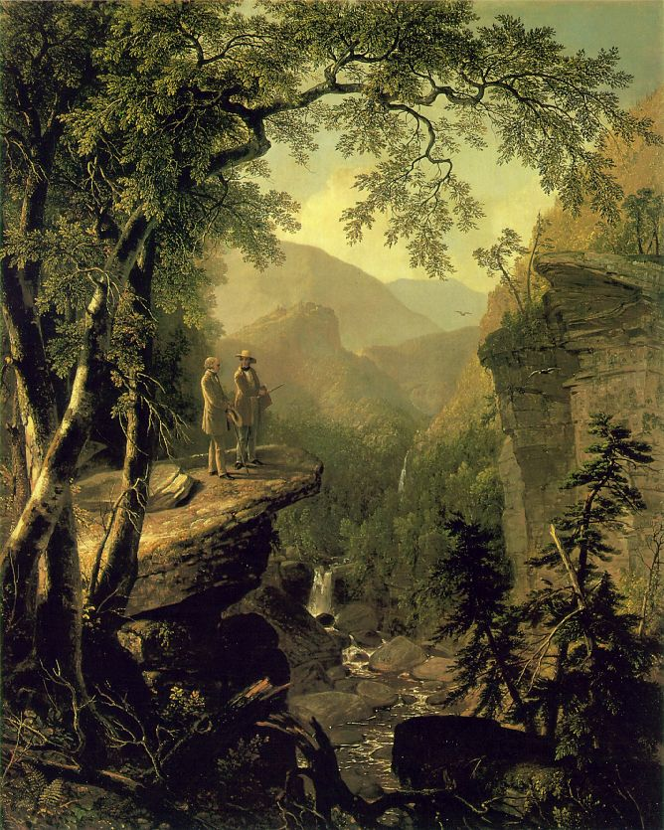
AMERICAN ROMANTICISM: INTRODUCTION (1800-1860)

Slide 2
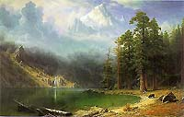
The Age of Reason or The Enlightenment
Founded on
Deism
Logic
Inalienable rights
It also brought
Industrialization, growth of cities, and factories
American expansion (Lewis and Clark and Manifest Destiny)
More encounters with Native Americans
Albert Bierstadt

Slide 3
ROMANTICISM: THE MOVEMENT
Question: What comes to mind or what do you associate with the term “Romanticism”?

Slide 4
Romanticism: a reaction to the Age of Reason
Idealism/Utopia
Glorification of the common man
Recognition of the nobility of the primitive
Imagination to engender faith and hope
Age of Reason
Romanticism
Realism
Patrician Classicism
Dominion over the Native American
Logic, always facts to counter fear and doubt

Slide 5
Romanticism
Characteristics:
The predominance of imagination over reason and formal rules
Primitivism
Love of nature
An interest in the past
Mysticism
Individualism
Idealization of rural life
Enthusiasm for the wild, irregular, or grotesque in nature
Enthusiasm for the uncivilized or “natural”

Slide 6
Characteristics
The Five I’s
  Imagination
  Intuition
  Idealism
  Inspiration
  Individuality

Slide 7

The City was a Place of . . .
The Rationalists saw the city as a place of industry, success, self realization, and civilization.
The Romantics saw the city as a place of poor work conditions, moral ambiguity, corruption, and death.

Slide 8
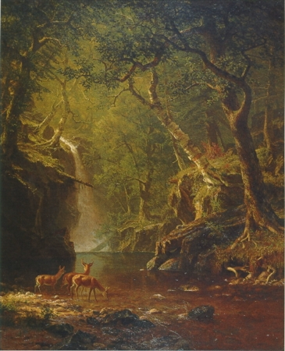
The Journey
Romanticism was often seen as a journey.
The journey from the city to the country
The journey from rational thought to the imagination

Slide 9
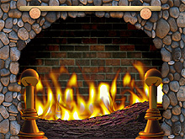
The Fireside Poets
The Most Popular American Poets of Their Time
John Greenleaf Whittier, William Cullen Bryant, James Lowell, Oliver Wendell Holmes
Their poems were often read aloud at the fireside as family entertainment.
It is poetry that seeks a higher truth from the natural world.

Slide 10
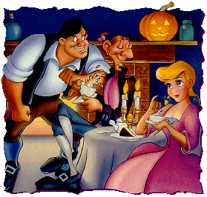

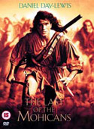
Literature
Folktales, regional writer
Washington Irving
The “Noble Savage”
James Fennimore Cooper
American Novelists looked to
westward expansion and the
frontier for inspiration.

Slide 11
The Arts
Romanticism was a movement across all the arts: visual art, music, and literature.
All of the arts embraced themes prevalent in the Middle Ages: chivalry, courtly love.
Shakespeare came back into vogue.

Slide 12
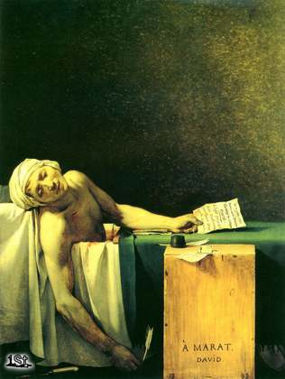
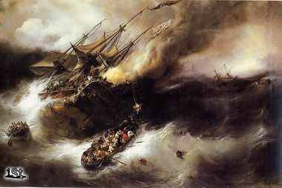
Visual Arts: Examples
Romantic Art
Neoclassical Art

Slide 13
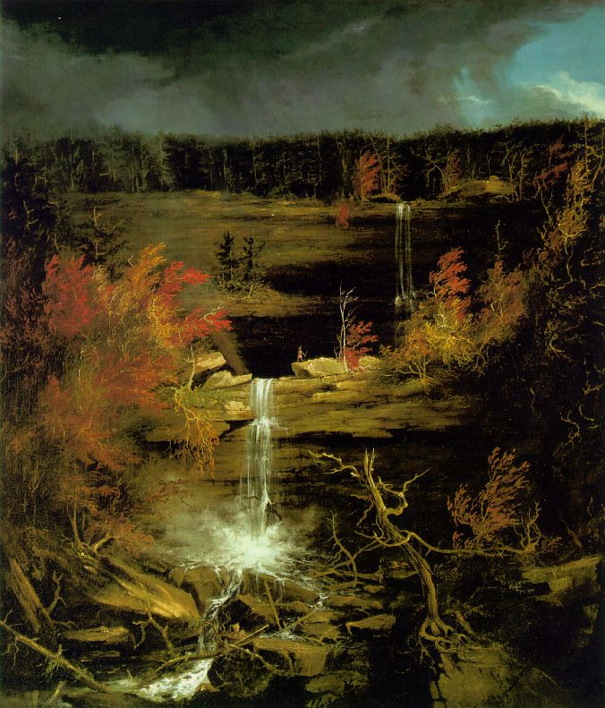
Thomas Cole,
“The Falls of Kaaterskill” (1826)
“

Slide 14
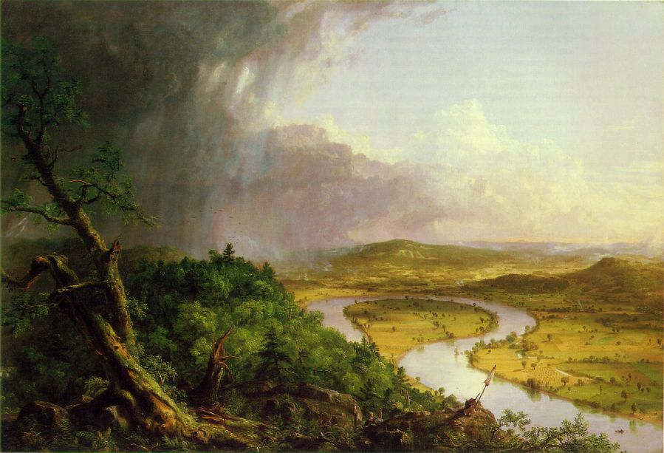
Thomas Cole, The Oxbow (View from Mount Holyoke, Northampton, Massachusetts, after a Thunderstorm, 1836)

Slide 15
Asher Durand, “Kindred Spirits” (1848)

Slide 16
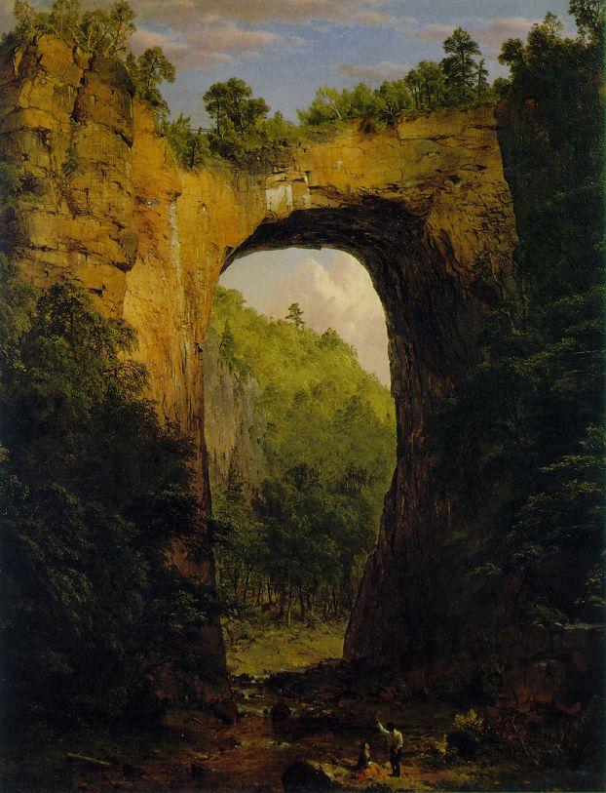
Frederic Edwin Church,
“The Natural Bridge” (1852)

Slide 17
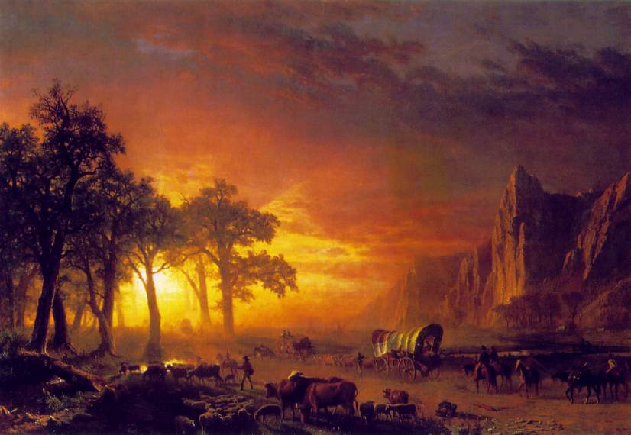
Alfred Bierstadt, “Emigrants Crossing the Plains” (1867)

Slide 18
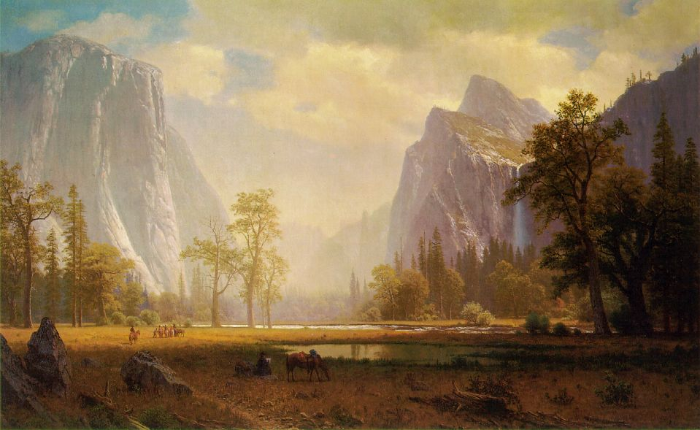
Alfred Bierstadt, “Looking Up the Yosemite Valley” (ca. 1865-67)

Slide 19
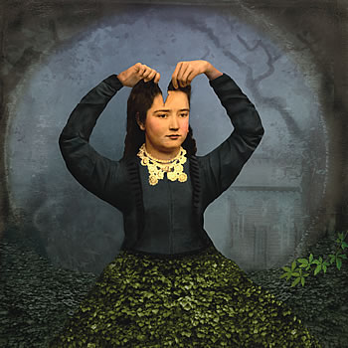
The Gothic Tradition

Slide 20
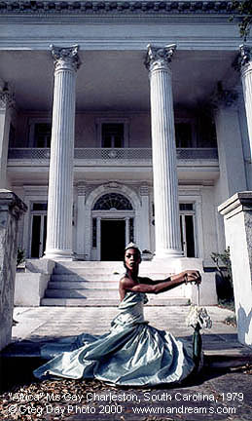
What is Gothic?
Originally named for the German “goths.”
Renaissance usage
Architecture, focus on the medieval, death, decay
17th-18th century novel

Slide 21
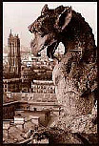
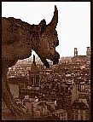
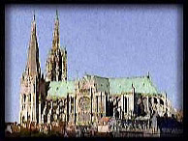
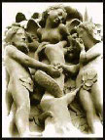
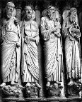
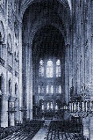
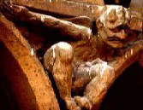

Slide 22
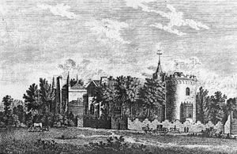
The Gothic Novel
Themes/motifs: Castles, darkness, madness secrets, ghosts, mystery, haunted houses
The Characters (stock characters): tyrants, villains, bandits, maniacs, Byronic heroes, persecuted maidens, femmes fatales, madwomen, magicians, vampires, werewolves, monsters, demons, revenants, ghosts, perambulating skeletons, the Wandering Jew and the Devil himself.

Slide 23

Supernatural/Gothic Literary Motifs
A motif is a repeated theme, image, or literary device. Look for these common supernatural/Gothic motifs in the works we will read

Slide 24
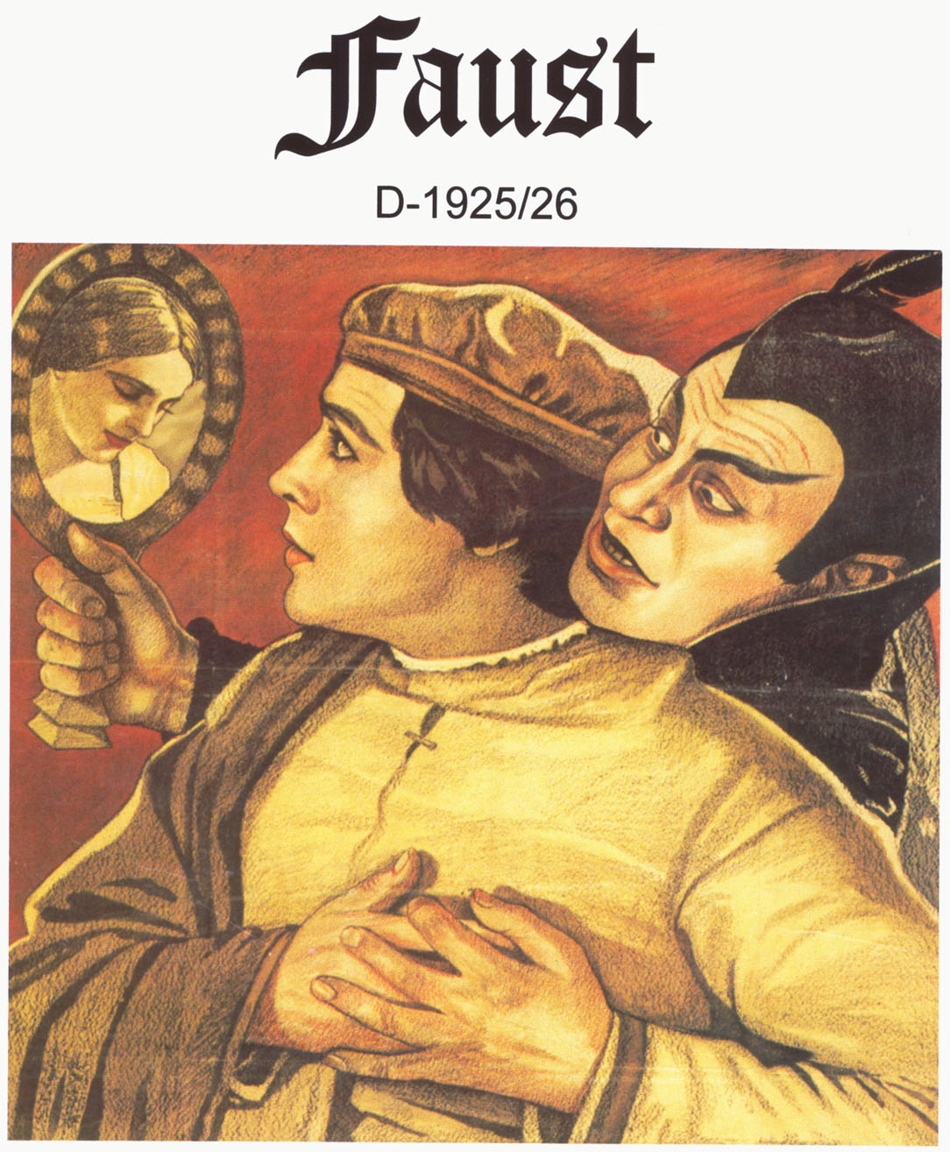
Forbidden Knowledge or Power/ Faust Motif:

Slide 25
Forbidden Knowledge or Power/ Faust Motif:
Forbidden knowledge/power is often the Gothic protagonist’s goal. The Gothic "hero" questions the universe’s ambiguous nature and tries to comprehend and control those supernatural powers that mortals cannot understand. He tries to overcome human limitations and make himself into a "god." This ambition usually leads to the hero’s "fall" or destruction; however, Gothic tales of ambition sometimes paradoxically evoke our admiration because they picture individuals with the courage to defy fate and cosmic forces in an attempt to transcend the mundane to the eternal and sublime.

Slide 26
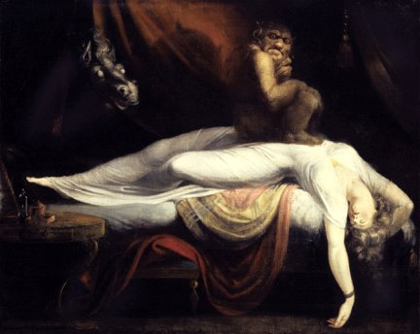
Dreams/Visions:
Terrible truths are often revealed to characters through dreams or visions. The hidden knowledge of the universe and of human nature emerges through dreams because, when the person sleeps, reason sleeps, and the supernatural, unreasonable world can break through. Dreams in Gothic literature express the dark, unconscious depths of the psyche that are repressed by reason— truths that are too terrible to be comprehended by the conscious mind.

Slide 27
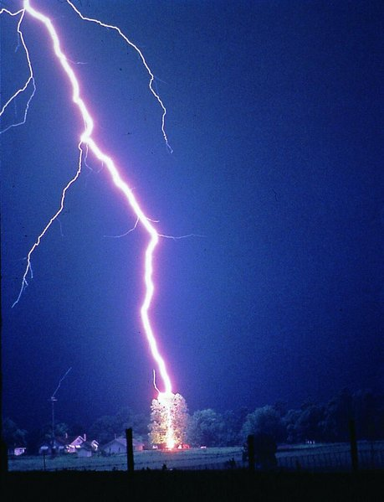

Signs/Omens:
Reveal the intervention of cosmic forces and often represent psychological or spiritual conflict (e.g., flashes of lightning and violent storms might parallel some turmoil within a character’s mind).

Slide 28
Examples of the Gothic Novel
Mary Shelley’s Frankenstein
Gaston Leroux’s The Phantom of the Opera
Bram Stoker’s Dracula
Many works by Edgar Allen Poe *
Nathanial Hawthorne
Poe and Hawthorne as pioneers in the American Gothic Tradition

Slide 29
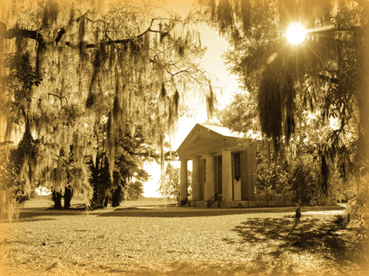
The Southern Gothic
Subgenre to the Gothic
Supernatural, ironic, unusual events guide the plot.
Focus on the American South

Slide 30
Characteristics of the Southern Gothic
The Southern Gothic author usually avoids perpetuating Antebellum stereotypes like the contented slave, the demure Southern belle, the chivalrous gentleman, or the righteous Christian preacher. Instead, the writer takes classic Gothic archetypes, such as the damsel in distress or the heroic knight, and portrays them in a more modern and realistic manner — transforming them into, for example, a spiteful and reclusive spinster, or a white-suited, fan-brandishing lawyer with ulterior motives.

Slide 31
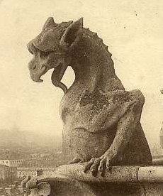
The Grotesque
In fiction, a character is usually considered a grotesque if he induces both empathy and disgust. (A character who inspires disgust alone is simply a villain or a monster.) Obvious examples would include the physically deformed and the mentally deficient, but people with cringe-worthy social traits are also included. The reader becomes piqued by the grotesque's positive side, and continues reading to see if the character can conquer his darker side.
Example: Victor Hugo’s The Hunchback of Notre Dame

Slide 32
Examples of Southern Gothic Writers
William Faulkner, Flannery O'Connor, Harry Crews, Lee Smith, Lewis Nordan, Barry Hannah, Carson McCullers, Erskine Caldwell, Eudora Welty, Harper Lee (To Kill a Mokingbird), Truman Capote, Tennessee Williams (A Street Car Named Desire), and Cormac McCarthy

Slide 33
O’Connor and the Southern Gothic Tradition…
Flannery O'Connor wrote, "Whenever I'm asked why Southern writers particularly have a penchant for writing about freaks, I say it is because we are still able to recognize one" ("Some Aspects of the Grotesque in Southern Fiction," 1960). In her often-anthologized short-story "A Good Man Is Hard To Find," the Misfit, a serial killer, is clearly a maimed soul, utterly callous to human life but driven to seek the truth. The less obvious grotesque is the polite, doting grandmother who is unaware of her own astonishing selfishness

Slide 34
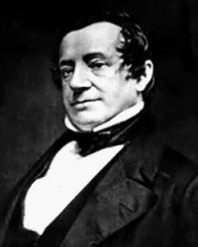
Washington Irving
Born at the end of the Revolutionary War on April 3, 1783
Considered the first professional man of letters in the United States
In 1809 A History Of New York, about imaginary 'Dietrich Knickerbocker'

Slide 35
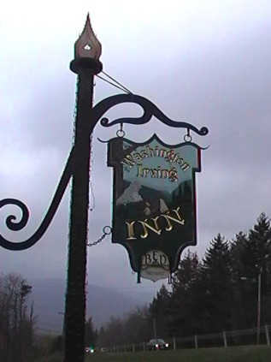
Lived for 17 years in Europe
Returned and lived with brother’s family in Tarrytown New York.
Died before the Civil war in 1859
Engaged to Matilda Hoffman who died at the age of 17 before they were married.
Never had any children.

Slide 36
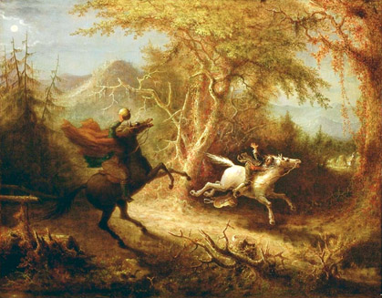
John Quidor 1801-1881
Romantic artist known for his illustrations of Washington Irving’s stories.
Romantic art/literature:
  Stylized
  Symbolic
  Sentimental
  Sylvan (nature)
The Headless Horseman Pursuing Ichabod Crane

Slide 37
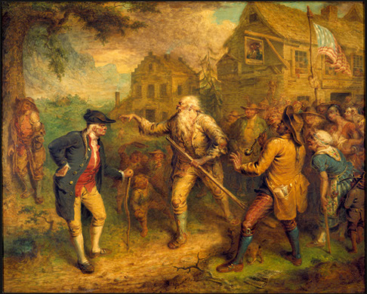
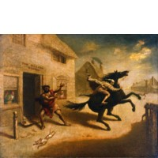
Other Works
The Devil and Tom Walker
Rip Van Winkle

Slide 38
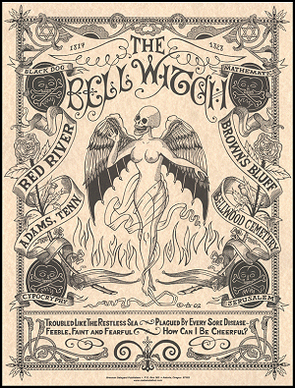
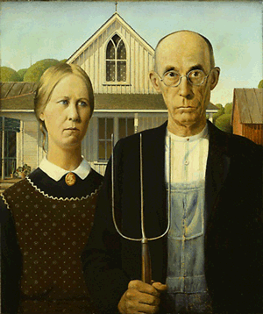
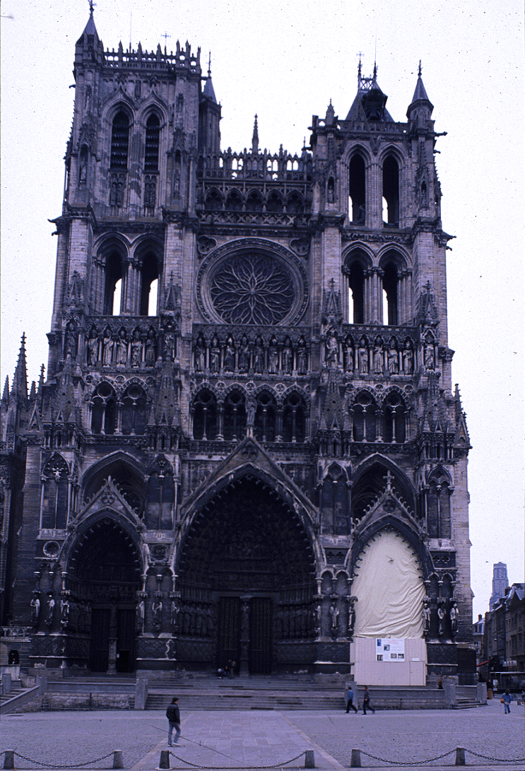
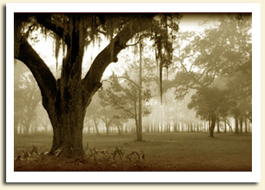
Visual Representations of the Gothic

Slide 39
